Slide 1
FAKE NEWS DETECTION
MANKALA SRUJAN
21ECB0B34
M SAI SREE VADAN
21ECB0B32

Slide 2
REFERENCE https://ieeexplore.ieee.org/stamp/stamp.jsp?tp=&arnumber=8546944
https://ieeexplore.ieee.org/stamp/stamp.jsp?tp=&arnumber=8100379

Slide 3
INTRODUCTION
Fake news is nothing but a content created with false information to mislead readers and spread false claims
Fake news and lack of trust in the media are growing problems with huge ramifications in our society
There even exist lots of websites that produce fake news almost exclusively. They deliberately publish hoaxes, propaganda and disinformation purporting to be real news – often using social media to drive web traffic and amplify their effect.
The main goal of fake news websites is to affect the public opinion on certain matters

Slide 4
SOME COMMON PROPERTIES OF FAKE NEWS ARTICLES
They often have a lot of grammatical mistakes
They often try to affect reader’s opinion on some topics in manipulative way like political issues.
They often use similar limited set of words very frequently to change the mindset of a reader.

Slide 5


Loading Libraries
Feature Extractaction
Importing Dataset
Train Test Split
Generate TFIDF
Training Naïve Bayes, logistic regression Models
Result

Slide 6
Libraries
Libraries used were:
Numpy
Pandas
Matplotlib.pyplot
Seaborn
Nltk

Slide 7
DATA SET
This Dataset was imported from Kaggle
This dataset was published by an American Newspaper organization The Onion
This dataset contains 24000 rows and 2 columns named Text and Label.

Slide 8
Feature Extraction
Calculate no. of words ,characters, stopwords in each row and add these 3 columns to the given data set.
Stopwords are the most frequently used words in the given corpus which has very less significance /posses no meaning like is ,an ,for etc.
Convert the column “text” to lower-case and remove special characters.
Remove stopwords from each row.

Slide 9
Lemmatization is replacing all the words with its lemma. Lemma is nothing but base or dictionary form of the word Example :Lemma for walking is walk, told is tell.
Perform Lemmatization for the given dataset.

Slide 10
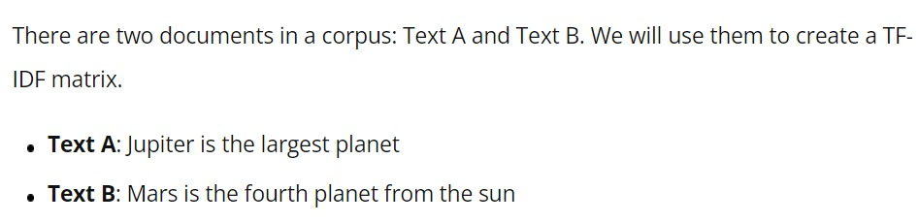
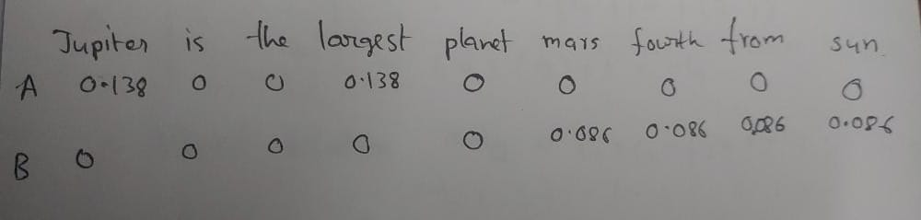
TFIDF Vectorizer
By applying TFIDF Vectorizer we can convert a corpus into the matrix of TFIDF values

Slide 11
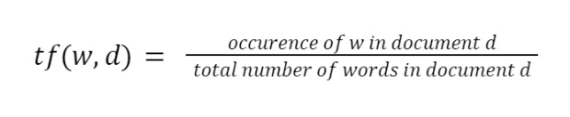
Term frequency (TF) :
It is the ratio of occurrence of word (w) in document (d) per total no. of words in the document.

Slide 12
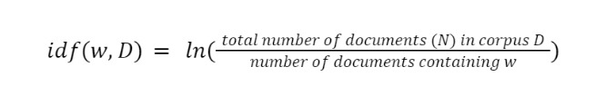
Inverse Document frequency (Idf):
It is the logarithm of ratio of total no. of documents(N) in corpus(D) to the no. of documents(d) containing word (w)

Slide 13

Term frequency Inverse Document frequency(TFIDF) :
It is the product of Term frequency and inverse document frequency

Slide 14
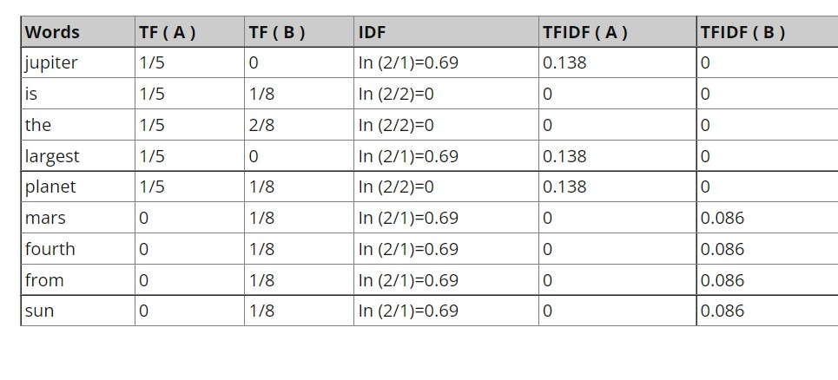

Slide 15
The conversion of above corpus data by using TFIDF vectorizer gives the following matrix containing TFIDF value for each word.
Find top 300 frequently repeated words in the given data set

Slide 16
Train Test split:
Before splitting the data obtained after TFIDF Vectorizer we need to add 3 more columns (word count, char count, stopwords) which we found earlier .
We will split the data into 75% for training and 25% for testing .

Slide 17
Naïve bayes classifier
In machine learning, naive Bayes classifiers are a family of simple probabilistic classifiers based on applying Bayes theorem(Conditional probability).
It assumes that all the features are unrelated to each other.
Here we are using the TFIDF values to identify whether the news article is fake or true.

Slide 18
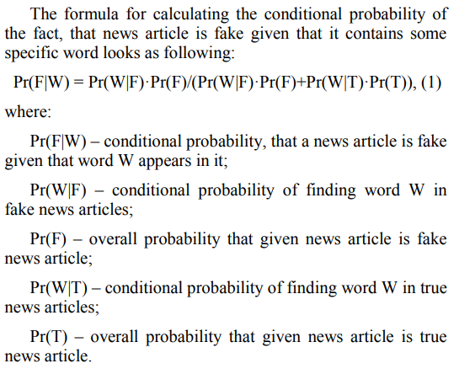
Mathematical Equations:
The probability of finding word W in fake news article is ratio of the fake news articles, that contains word W to the total number of fake news articles.

Slide 19
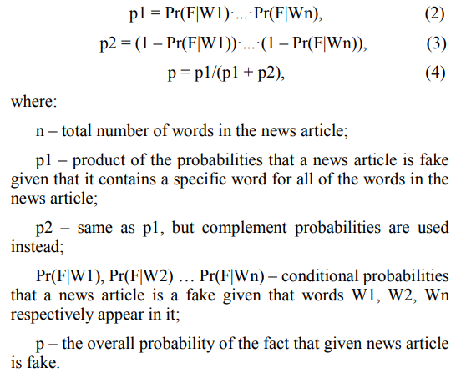
We use threshold value to classify i.e. , if p is greater than threshold value it will be 1 and if p is less than threshold value it will be 0.

Slide 20
Logistic regression
Logistic Regression is a supervised machine learning technique which predicts the categorical dependent variable using given independent variables.
As it predicts the categorical dependent variable ,the output must be 0 or 1 ,yes or no ,true or false , but instead it gives probabilistic values which lie between 0 and 1.
We assume the output must be categorical and independent variables ha no multi-collinearity/very less multi-collinearity.
We use sigmoid function in Logistic Regression.

Slide 21
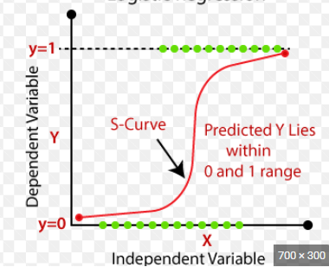
Sigmoid Function:
The sigmoid function will map the predicted values to probabilities.
It is an S-shaped curve which has range from “0” to “1”.
As we move towards infinity the curve tends to 1 and as we towards negative infinity the curve tends to 0.
We use threshold value concept to classify . If the probability is higher than threshold value then we can say predicted value is 1 and less than threshold value it is 0.

Slide 22
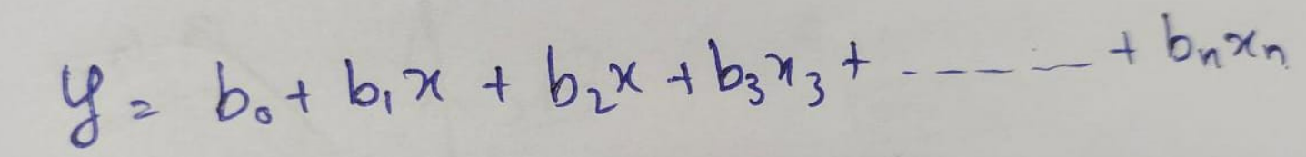
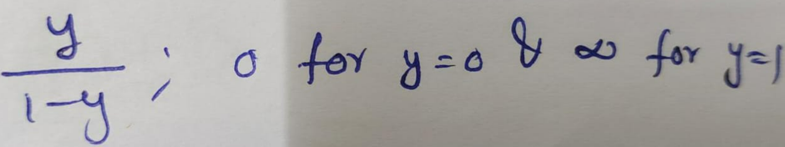
Logistic Regression Equations:
The Logistic regression equation will obtain from linear regression equation.
We know linear regression equation with n independent variables is
In Logistic Regression y can be between 0 and 1 only, so for this let's divide the above equation by (1-y).

Slide 23
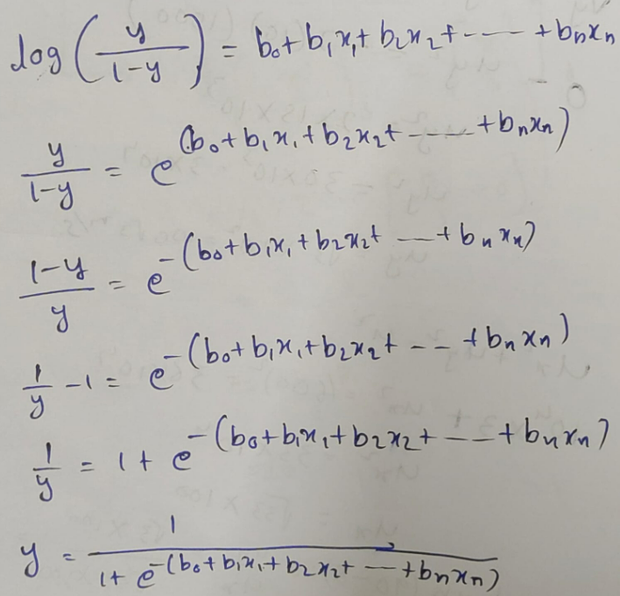
But we need range between -[infinity] to +[infinity], then take logarithm of the equation it will become

Slide 24
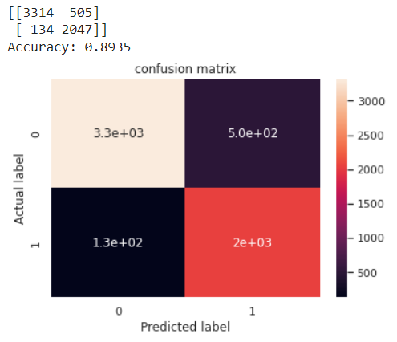
Output
Confusion matrix for Naïve bayes model

Slide 25
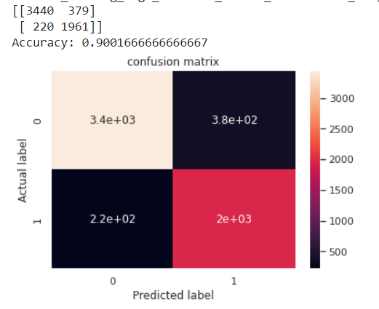
Confusion matrix for logistic regression model

Slide 26
The google collab’s hyperlink of code of our project-
https://colab.research.google.com/drive/1isUVkHAmLiUcK_6ZuEjo3Dsy_WV8JvPW#scrollTo=_IGl5uB1bUY3

Slide 27
THANK YOU

